Slide 1

www.espirity.com
Eclipse Introduction
Dwight Deugo (dwight@espirity.com)
Nesa Matic (nesa@espirity.com)
Notes:
Portions of the notes for this lecture include excerpts from the Eclipse 3.0 and 3.1 Help facility. These excerpts are made available under EPL for ease of use by instructors, (c) Copyright (c) 2000, 2005 IBM Corporation and others. For more complete information instructors are encouraged to read the full notes from the Eclipse Help facility.

Slide 2
Additional Contributors
None as of September, 2005

Slide 3
Module Overview
Overview
Installing and Running
Notes:
Let’s begin with an overview of Eclipse.

Slide 4
Module Road Map
Overview
  Background
  Architecture
  Components
  Usage scenarios
Installing and Running
Notes:
Let’s begin with an overview of Eclipse.

Slide 5
What is Eclipse?
Eclipse is an open source project
  http://www.eclipse.org
  Consortium of companies, including IBM
  Launched in November 2001
  Designed to help developers with specific development tasks
Notes:
The Eclipse Project was designed to provide a platform for building of highly integrated development tools. It was initiated by IBM with a consortium of companies, which now include companies such as Borland, Fujitsu, HP, Hitachi, Object Management Group, Oracle, Parasoft, QNX Software Systems, Red Hat, SAP, and Sybase, in 2001.

Slide 6
Projects
Consists of many separate projects:
  Eclipse Project
  Eclipse Tools Project
  Eclipse Technology Project
  Eclipse Web Tools Platform Project
  The Eclipse Test and Performance Tools Platform (TPTP) Project
  Business Intelligence and Reporting Tools (BIRT) Project
  Data Tools Platform Project (DTP)
  Device Software Development Platform (DSDP)
Notes:
The mission of the Eclipse Technology Project is to provide new channels for open source developers, researchers, academics and educators to participate in the on-going evolution of Eclipse.
The Eclipse Tools Project is designed to support building of variety of tools for The Eclipse Project. It provides single point of access to all tool developers to avoid overlapping and duplication in developing Eclipse tools.
The Eclipse Technology Project is designed to provide mechanism for on-going evaluation of Eclipse to developers, researchers, academics and educators.
The mission of the Web Tools Platform Project is to build a generic, extensible and standards-based tool platform upon which software providers can create specialized, differentiated offerings for J2EE and Web-centric application development.
he mission of the Eclipse Test & Performance Project is to build a generic, extensible, standards-based tool platform upon which software developers can create specialized, differentiated, and interoperable offerings for world class test and performance tools.
The mission of the BIRT project is to address a wide range of reporting needs within a typical Java application.
Using a model-driven approach, the Data Tools Platform Project (DTP) consists of extensible frameworks and exemplary tools for data-centric applications.
The goal of the Device Software Development Platform (DSDP) is to provide frameworks and exemplary tools to support activities in each phase of the device software development process.

Slide 7
IBM’s IDE History
1994
VisualAge for Smalltalk
1996
VisualAge for Java
VisualAge Micro Edition
2001
Eclipse Project
Notes:
In 1994 IBM has released VisualAge for Smalltalk, an IDE written in Smalltalk, meant to be used for developing Smalltalk applications.
When Java became popular, IBM has released VisualAge for Java, a Java IDE that was written in Smalltalk as well. Soon, the IDE gained great popularity.
In 2001 IBM has started Java based open-source initiative called Eclipse.

Slide 8
The Eclipse Platform Motivation
Application development tools construction support
Independent tool vendors support
GUI and non-GUI application development support
Numerous content types support
  Java, HTML, C, XML, ...
Easy integration of tools
Use of Java language for writing the tools
Multiple operating systems support

Slide 9
Plug-in Architecture
Eclipse Platform
Tool
(plug-in)
Workbench
Help
Tool
(plug-in)
…
Workspace
Team
Tool
(plug-in)
Platform Runtime
Notes:
The picture on this slide represents the high-level architecture of the Eclipse Platform.
All plug-ins must be added to the platform before it’s started. When platform is started, the Platform Runtime figures out what plug-ins are available and creates plug-in in-memory registry.
Team and Help on the picture represent existing “hooks” in Eclipse for adding help and team support to the applications and environment.
The Platform has 2 main components: the Workbench and the Workspace. The Workbench represents set of tools available for the user in the Eclipse environment and Workspace represents set of user defined components (projects, packages, classes, and more).

Slide 10
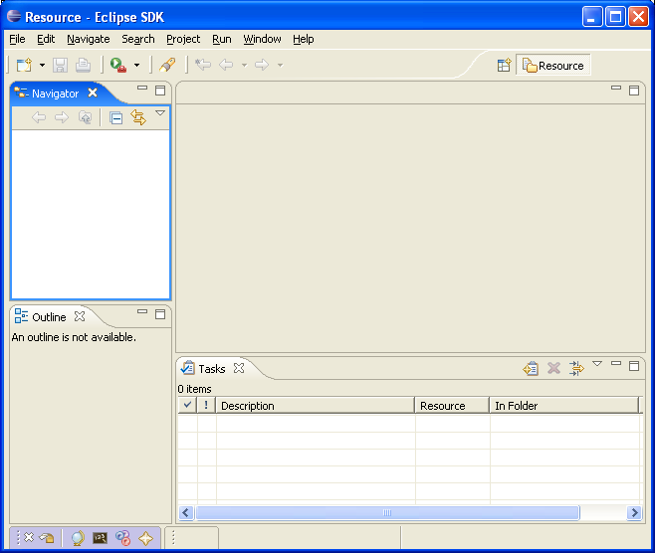
Workbench
Represents the desktop development environment
  It contains set of tools for resource management
  It provides common way of navigating through the resources
Multiple workbenches can be opened at the same time
Notes:
The term Workbench refers to the desktop development environment. The Workbench aims to achieve seamless tool integration and controlled openness by providing a common paradigm for the creation, management, and navigation of Workbench resources.
Each Workbench window contains one or more perspectives. Perspectives contain views and editors and control what appears in certain menus and tool bars. More than one Workbench window can exist on the desktop at any given time.

Slide 11
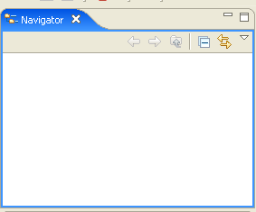
Workspace
Represents users data
It is a set of user defined resources
  Files
    Contain arbitrary number of bytes
  Folders
    Contain other folders or files
  Projects
    Collections of files and folders
Notes:
The central hub for your user's data files is called a workspace. You can think of the platform workbench as a tool that allows a user to navigate and manipulate the workspace. The resources plug-in provides APIs for creating, navigating, and manipulating resources in a workspace. The workbench uses these APIs to provide this functionality to the user. Your plug-in can also use these APIs.
From the standpoint of a resource-based plug-in, there is exactly one workspace, and it is always open for business as long as the plug-in is running. The workspace gets opened automatically when the resources plug-in is activated, and closed when the platform is shut down. If your plug-in requires the resources plug-in, then the resources plug-in will be started before your plug-in, and the workspace will be available to you.
The workspace contains a collection of resources. From the user's perspective, there are three different types of resources: projects, folders, and files. A project is a collection of any number of files and folders. It is a container for organizing other resources that relate to a specific area. Files and folders are just like files and directories in the file system. A folder contains other folders or files. A file contains an arbitrary sequence of bytes. Its content is not interpreted by the platform.
A workspace's resources are organized into a tree structure, with projects at the top, and folders and files underneath. A special resource, the workspace root resource, serves as the root of the resource tree. The workspace root is created internally when a workspace is created and exists as long as the workspace exists.
A workspace can have any number of projects.
Files and folders are similar to files and directories in the file system.
In the picture above we see MyServlet and MyWeb defined as projects and we see an images folder containing two files: .project and index.html

Slide 12
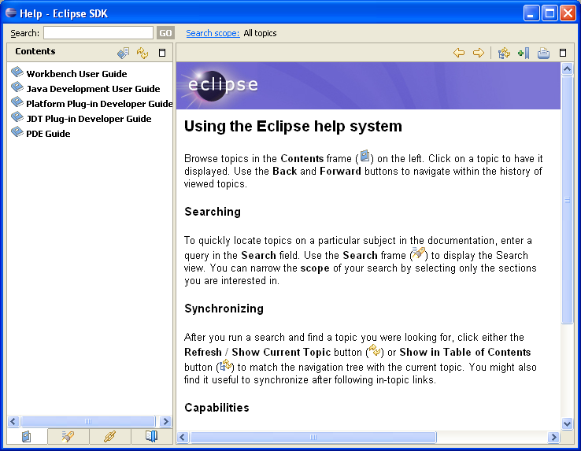
Help
Used for creating and publishing documentation
There are two different documentation styles:
  Help style documentation is published in the user guide
  API documentation is published in the programmer guide
Help content is in HTML format
Help navigation is in XML format
Notes:
The online help system provides access to the documentation, and lets you browse, search, and print it. The documentation is organized into sets of information that are roughly analogous to books. These, along with a full-text search engine and context-sensitive interface help, are designed to help you find the information you need.
The Eclipse platform's help facilities provide you with the raw building blocks to structure and contribute documentation to the platform. It does not dictate structure or granularity of documentation. You can choose the tools and structure for your documentation that suits your needs. The help plug-in allows you to describe your documentation structure to the platform using a table of contents (toc) file.
Your plug-in's online help is contributed using the org.eclipse.help.toc extension point. You can either contribute the online help as part of your code plug-in or provide it separately in its own documentation plug-in.

Slide 13
Team
Provides support for:
  Versioning
  Configuration management
  Integration with team repository
Allows team repository provider to hook into the environment
  Team repository providers specify how to intervene with resources
Has optimistic and pessimistic locking support
Notes:
The Eclipse Platform provides basic hooks for plugging team repository into the environment. There are different workflows for different team repository providers, and the platform lets providers to make decisions how resource management will be implemented.
In the pessimistic model, user checks out the resource and than the resource is locked for everybody else.
In the optimistic model, user can modify the resource while somebody else is modifying it as well. This usually results into manual intervention of modified resource – merging of two resource modifications.

Slide 14
How is Eclipse Used?
As an IDE - Integrated Development Environment
  Supports the manipulation of various content types
  Used for writing code
As a product base
  Supported through plug-in architecture and customizations

Slide 15
Eclipse as an IDE
Java Development Tooling (JDT) is used for building Java code
Provides set of workbench plug-ins for manipulating Java code
  Java projects, packages, classes, methods, ....
Java compiler is built in
  Used for compiling Java code
  Creates errors (special markers of code) if compilation fails
Notes:
Java Development Tooling provides set of plug-ins used for writing Java code. These plug-ins help in creating Java projects, packages, classes, methods, variables, and debugging code. Together they make a robust Java IDE.

Slide 16
Eclipse as a Product Base
Eclipse can be used as a Java product base
Its flexible architecture used as a product framework
  Reuse plug-in architecture
  Create new plug-ins
  Customize the environment
Notes:
When you use Eclipse as a product platform, you add your new features as plug-in to the standard directories of Eclipse: ..eclipse\plugins, and …eclipse\features. You then update the install.ini file to identify your primary features you use eclipse.exe to start the user interface. More details steps are identified in other modules.

Slide 17
Module Road Map
Overview
Installing and Running Eclipse
  Where to get Eclipse?
  What is the support for Eclipse?
  Installing Eclipse
  Running Eclipse
Notes:
Let’s look at installing and running Eclipse.

Slide 18
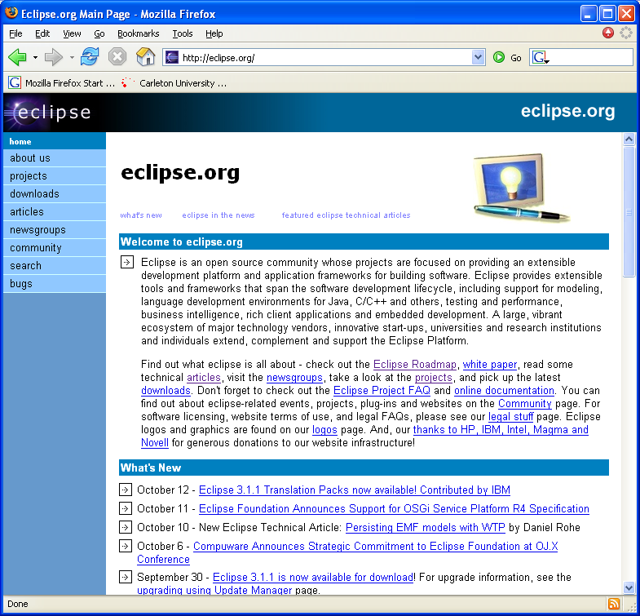
Getting Eclipse
Notes:
You can download eclipse by going to the Eclipse’s home page: http://www.eclipse.org

Slide 19
http://www.eclipse.org
Main point for finding Eclipse resources
  Downloads
  Articles
  Discussion groups
  Bugs
Contains various resources for using Eclipse
Contains references to other Eclipse related sites
Notes:
The Eclipse.org web page is your main source for finding and accessing Eclipse resource: downloads, articles, discussion groups, bug reports, and other references.

Slide 20
Downloading Eclipse’s Install Zip File
Click on the Download from the main page on http://www.eclipse.org
  Choose the closest site from which to download (geographical sites hosting the download)
  Choose the build for download (usually the latest build)
  Choose the platform for download and type of download (http or ftp)
  Specify where to save the download locally
Notes:
The download web page has many options for you to select from. These options include the closest download site, the build version, and the platform. Before the download begins, you will also be asked the name of the local directory to store the install zip file.

Slide 21
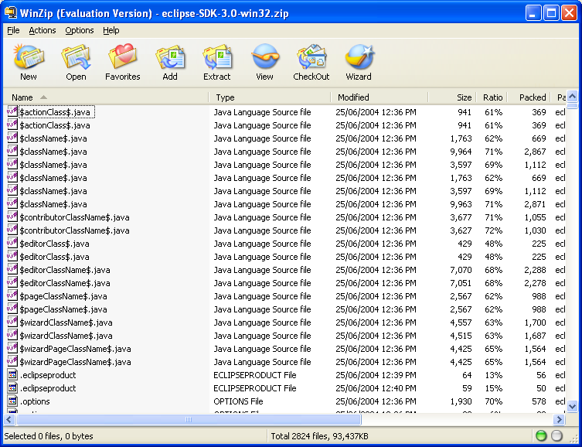
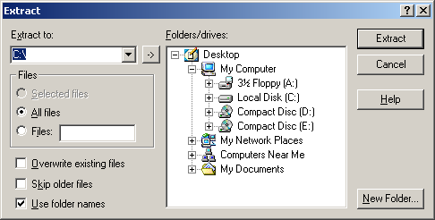
Installing the Eclipse
Unzip the downloaded file to the directory of your choice
Notes:
To install Eclipse, unzip the download file (eclipse-SDK-3.0-win32.zip) to a directory of your choice.

Slide 22
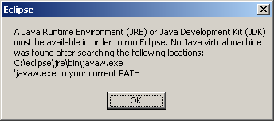
eclipse.exe
Eclipse is run by double-clicking on the eclipse.exe file
  The file is located in the Eclipse installation directory
If there is no path set for javaw.exe program, the following dialog will come up
Notes:
Eclipse is run by double-click on the eclipse.exe program that is located in the Eclipse installation directory, i.e. in the directory where downloaded zip file is unzipped.
If you don’t have Java Virtual Machine (JVM) set up in your path, a dialog will come up indicating that no JVM was found for running Eclipse. If you are missing a JVM, see the next slide.

Slide 23
Missing a Java VM? …
Download the latest Java Runtime Environment (JRE), e.g., v1.5.0_03 from http://java.sun.com/j2se/
Click on the downloaded EXE file to install
When given the option by the installer, identify a directory of your choice for the install files
Update the PATH environment variable to include the JRE’s bin directory
Notes:
One can download the latest Java Runtime Environment (JRE), e.g., v1.4.1_02, using the links found at http://java.sun.com/j2se/. Once the JRE’s “exe” file is downloaded, simply click on it to install. When given the option by the installer, identify a directory of your choice for the install files.
Once the installation has completed, you will need to update the PATH environment variable to include the JRE’s “bin” directory.

Slide 24
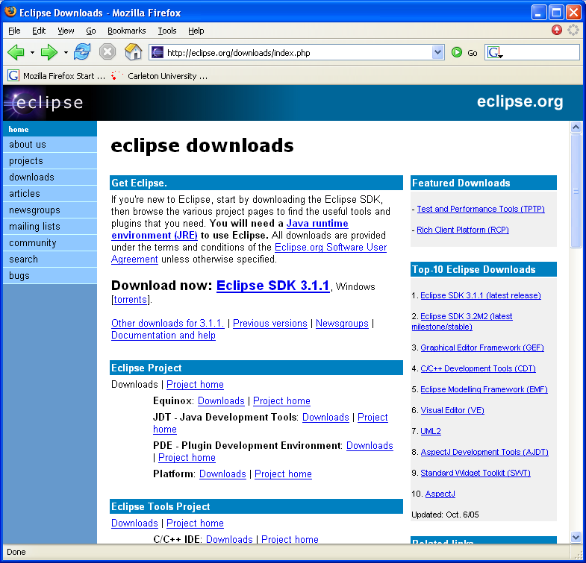
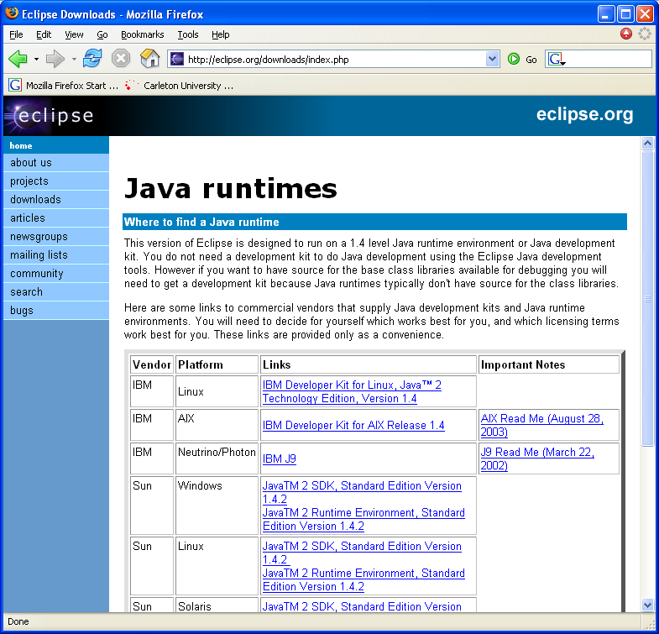
… Missing a Java VM?
Other VMs are available at the Eclipse download web site

Slide 25
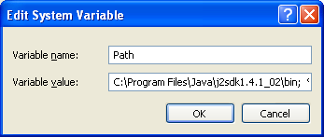
Specifying JVM
There are two ways of specifying JVM for Eclipse:
  By installing JVM under the \jre\ directory off the eclipse install directory
  By specifying existing JVM in the PATH environment variable
Start -> Control Panel -> System ->Advanced -> Environment Variables
Notes:
If JVM is already installed on the local system, simply set the PATH environment variable to indicate to the Eclipse where to find JVM.
If a JVM specific to Eclipse need to be used, it might be better idea to have it under \jre\ directory of the Eclipse installation directory.

Slide 26
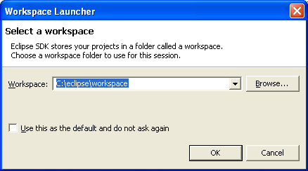
Specifying Workspace
The workspace contains user defined data – projects and resources such as folders and files
Eclipse prompts for a workspace location at the startup time
The prompt could be turned off
Notes:
By default, Eclipse uses a Workspace to store your projects, their resources and other information. Eclipse’s default works space is directory in your Eclipse installation directory called \workspace. You can change the default locations in the prompt or with arguments to the eclipse.exe.

Slide 27
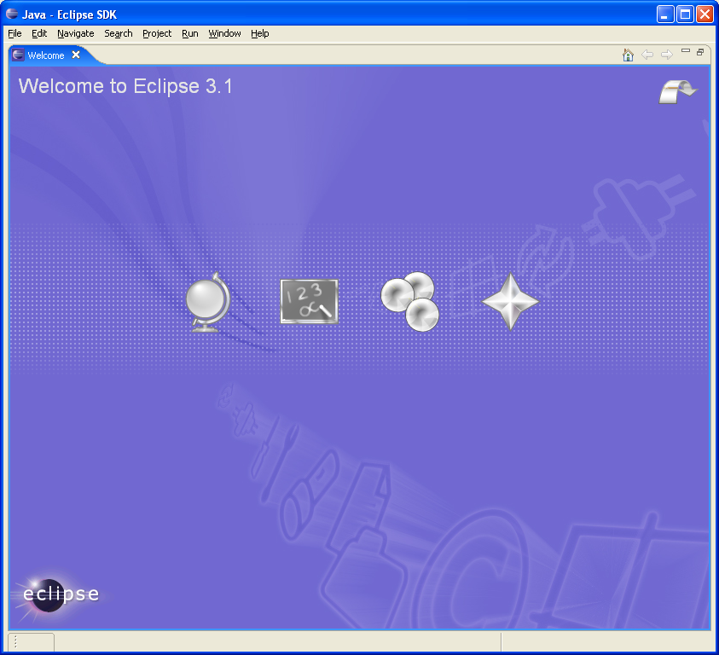
Running Eclipse
When Eclipse is run, a Welcome page opens
Notes:
Double click on the eclipse.exe found in the Eclipse install directory to run Eclipse and see the opening Workspace.

Slide 28
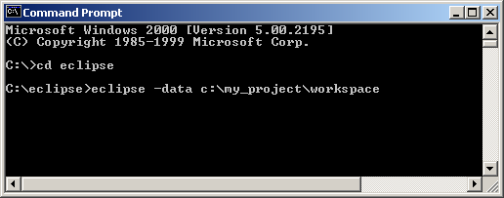
Running Different Workspace …
It is possible to run different workspaces using command prompt
  -data argument must be used with eclipse.exe
  Workspace location must be specified
Useful for grouping project specific data
Multiple workspaces can run at the same time
Notes:
For creating a new workspace, its location needs to be specified as an argument to eclipse.exe. The remainder of the work (meta data information) is done by the Eclipse.

Slide 29
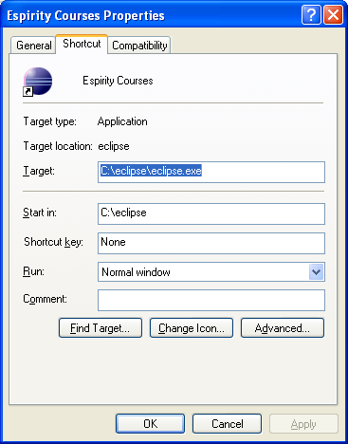
… Running Different Workspace
Customize your working directory by creating a shortcut identifying the eclipse.exe and the working directory
Notes:
To make starting Eclipse easy, create a shortcut (Windows only) specifying the location of the eclipse.exe and the default directory. Place the shortcut on the desktop for easy access.

Slide 30
Module Summary
In this module you have learned:
  What Eclipse is, its background and components
  How Eclipse is used
  How to download, install and run Eclipse
  How to create and run multiple workspaces with Eclipse

Slide 31

Labs!
Lab: Installing and Running Eclipse
Notes:
Now it’s time for the lab.

